Slide 1
Wiegmann Wisdom
Wiegmann Website Review
5/14/2020
WWW.HUBBELL.COM/WIEGMANN/EN/

Slide 5
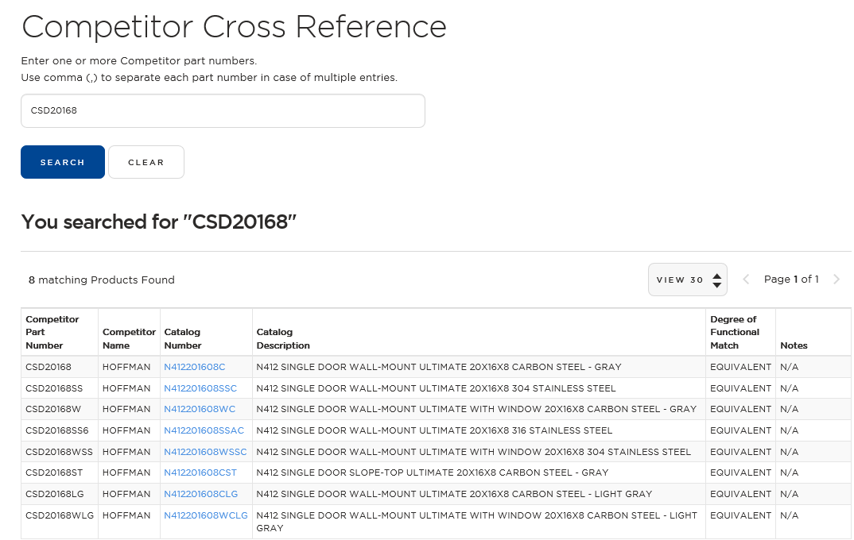

Slide 7
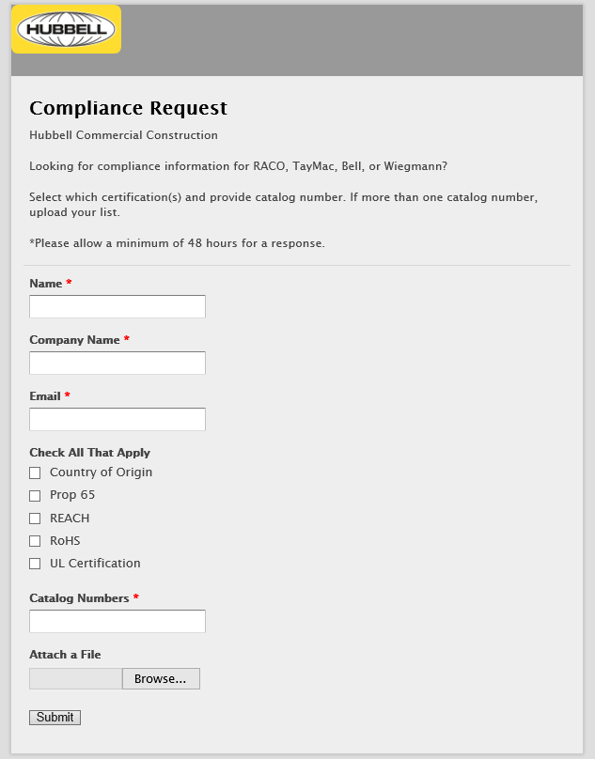

Slide 9
